Slide 1

The Evolving Role of AI Developers
Navigating the Future of Technology

Slide 2
Agenda
Overview
Significance of AI
Knowledge Required for AI Developers
AI Project Lifecycle
Prompt Engineering
Exploring Different LLM Types
Design Patterns and AI Orchestrator
Low Code vs Full Code Development
Conclusion
Notes:
Agenda * Overview * Introduction * Agenda * Significance of AI * Why AI is Important * Expansion of AI Across Industries * Investment and Growth in AI * Knowledge Required for AI Developers * Core Skills * Generative AI * Getting Started with AI Development * AI Project Lifecycle * AI Project Lifecycle * Setting the Scene with Business Insights * Languages Involved * Data Storage Solutions * Prompt Engineering * Advanced Prompt Engineering * Prompt Engineering Example * Basic Prompt Engineering * Exploring Different LLM Types * Comparing LLM Types * Azure Open AI * Design Patterns and AI Orchestrator * Low Code – Copilot Extensibility * Design Patterns Table * AI Orchestrator Details * Design Patterns * Low Code vs Full Code Development * Low Code vs Full Code * Steps in an AI Project * Conclusion * Demo * References

Slide 3









RocketMinders
www.linkedin.com/in/luismanez
www.linkedin.com/in/rubentg
luis.manez@outlook.com
rtoribiogallardo@gmail.com
github.com/luismanez
github.com/Rtoribiog
twitter.com/luismanez
twitter.com/Rtoribiog
Luis Mañez
Ruben Toribio
RocketMind Academy CTO
RocketMind Academy CEO
Azure AI + M365 Development MVP
AI Expert / Full stack developer
https://rocketmindacademy.com/
Notes:
Rubén Toribio, an M365 Architect and Full Stack AI Developer at DNV, discusses the evolving role of AI developers and how they navigate the future of technology. Original Content: THE EVOLVING ROLE OF AI DEVELOPERS: NAVIGATING THE FUTURE OF TECHNOLOGY Rubén Toribio M365 Architect / Full Stack – AI Developer DNV

Slide 4

Why Generative AI is Important
Notes:
The document simply asks 'Why?' Original Content: Why?

Slide 5
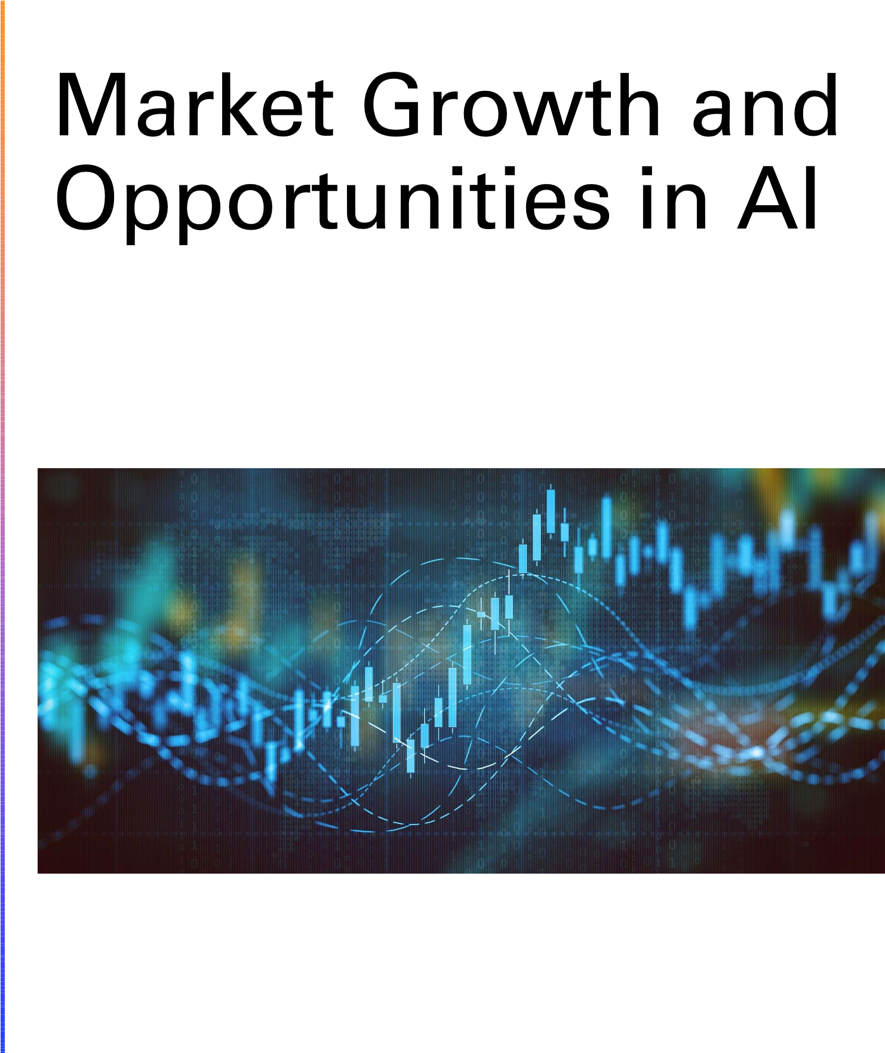
Expansion of AI Across Industries
Healthcare
AI applications in diagnostics and treatment
Improved patient care and management
Finance
AI in fraud detection and risk management
Enhanced financial forecasting and analysis
Automotive
AI in autonomous driving technology
Optimized manufacturing processes
Notes:
AI is expanding across various industries such as healthcare, finance, and automotive. In healthcare, AI improves diagnostics and patient care. In finance, it enhances fraud detection and forecasting. In automotive, AI optimizes manufacturing and enables autonomous driving. Original Content: • Expansion of AI across industries (healthcare, finance, automotive)

Slide 6

Investment and Growth in AI
Increasing investment in AI technologies
Significant capital being directed towards AI research and development
Companies focusing on AI to enhance their products and services
Projected growth rates for AI market size
AI market expected to expand rapidly in the coming years
Forecasts indicate substantial revenue growth
Emerging sectors within AI
New industries adopting AI solutions
Innovative applications in healthcare, finance, and more
Notes:
Investment in AI technologies is increasing, with significant capital directed towards research and development. The AI market size is projected to grow rapidly, with substantial revenue forecasts. Emerging sectors within AI include innovative applications in various industries such as healthcare and finance. Original Content: • Increasing investment in AI technologies • Projected growth rates for AI market size • Emerging sectors within AI (e.g.,

Slide 7
Core Skills
Selecting and deploying AI models
Selecting effective AI models for various applications
Ensuring models are scalable and efficient
Collaborating with cross-functional teams to integrate AI solutions
Working with different departments to implement AI
Ensuring seamless integration of AI technologies
Continual learning to keep up with AI advancements
Staying updated with the latest AI trends
Programming languages
Understanding of machine learning algorithms
Proficiency in AI development tools and platforms
Basics of data science and analytics
Notes:
In AI development, key responsibilities include designing and deploying AI models, collaborating with teams, and continual learning. Essential skills involve proficiency in programming languages like Python, understanding machine learning algorithms, using AI tools, and basics of data science. Original Content: • Designing, developing, and deploying AI models • Collaborating with cross-functional teams to integrate AI solutions • Continual learning to keep up with AI advancements • Programming languages (e.g., Python, .NET , JavaScript) • Understanding of machine learning algorithms • Proficiency in AI development tools and platforms • Basics of data science and analytics

Slide 8
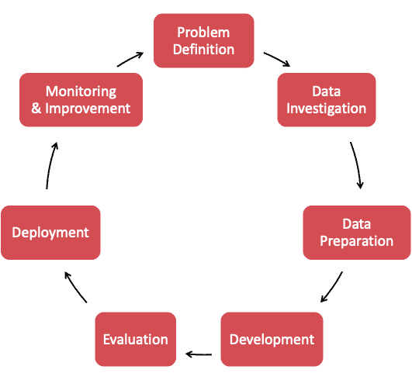
AI Project Lifecycle
Identifying a Problem
Recognize the issue that needs an AI solution
Selecting Relevant Data
Gather data pertinent to the problem
Choosing an Appropriate AI Model
Select a model that fits the data and problem
Entering the Training Phase
Train the AI model with the selected data
Strategizing for Effective Deployment
Plan how to implement the AI solution effectively
Notes:
The AI project lifecycle includes identifying a problem, selecting relevant data, choosing an appropriate AI model, training the model, and strategizing for effective deployment. Original Content: • AI Project Lifecycle This process outlines identifying a problem, selecting relevant data, choosing an appropriate AI model, entering the training phase, and strategizing for effective deployment.

Slide 9

Steps in an AI Project
Problem identification
Defining the problem to be solved
Understanding the requirements and constraints
Data collection and preprocessing
Gathering relevant data
Cleaning and preparing data for analysis
Model selection, training, and evaluation
Choosing the appropriate model
Training the model with collected data
Evaluating model performance
Deployment and monitoring
Developer's involvement
Notes:
An AI project involves several key steps: identifying the problem, collecting and preprocessing data, selecting, training, and evaluating models, and deploying and monitoring the solution. Developers are central to each phase, ensuring smooth transitions from conceptualization to deployment. Original Content: Steps in an AI Project and the Developer's Involvement • Problem identification • Data collection and preprocessing • Model selection, training, and evaluation • Deployment and monitoring • Central to each phase, from conceptualization to deployment

Slide 10

Basic Prompt Engineering
System Messages
Guide user interactions
Few-shot Learning
Enhances AI's understanding with minimal examples
Cues and Clear Syntax
Simplify tasks
Ensure effective grounding
Notes:
Prompt-engineering involves using system messages to guide interactions, few-shot learning to enhance AI understanding, and cues with clear syntax to simplify tasks and ensure effective grounding. Original Content: • Prompt-engineering System messages guide user interactions, while few-shot learning enhances AI's understanding with minimal examples. Cues and clear syntax simplify tasks, ensuring effective grounding.

Slide 11
Advanced Prompt Engineering
Objective
Audience
Tone
Complexity
Keywords
Instructions
Constraints
Context
Format
Examples
Follow-Up
Evaluation Criteria
Notes:
Prompt engineering involves generating creative stories with specific objectives, audience, tone, and complexity. It includes keywords, instructions, constraints, context, format, examples, follow-up questions, evaluation criteria, adjustments, and feedback loops. Original Content: Prompt-engineering "promptEngineering": { "objective": "Generate a creative story about a dragon and a knight.", "audience": "OpenAI's GPT model.", "tone": "Friendly, professional, humorous, etc.", "complexity": "Simple for general audience, complex for technical fields.", "keywords": [ "Creative story", "dragon", "knight" ], "instructions": "Describe, explain, list, create, etc.", "constraints": "Keep the story under 500 words, avoid violence.", "context": "A brief history of the dragon and knight’s rivalry.", "format": "Bullet points, essay, dialogue, etc.", "examples": "Example of a creative opening sentence.", "followUp": "If the story focuses more on the dragon, ask about the knight's perspective.", "evaluationCriteria": [ "Creativity", "adherence to instructions", "grammatical correctness", "engagement level of the story" ], "adjustments": "Use more specific keywords, change the tone, provide more detailed instructions or context.", "feedbackLoop": "Analyzing response effectiveness and adjusting prompt parameters accordingly." } Prompt-engineering • Basic • generate an image of a boy with a green t-shirt with a print in the middle • Advanced • Context: You work for an advertising agency called Mr. Anuncios. An agency focused on creating advertising for children's clothing brands, for children between 6 and 10 years old. A modern and avant-garde brand that seeks to position itself as one of the best in Spain. Your role will be to act as creative director for a clothing collection. • Request: I want you to be very creative and daring and generate an image of a boy with a green t-shirt with a print in the middle. The pants on the other hand will be denim. The image should be full body. Make it a vivid and attractive image. • Language: not necessary. • Structure: an original, unique and realistic image.

Slide 12

Languages Involved
Languages Involved
Mainly Python
Coming JS
.NET
Java
Notes:
The project involves several programming languages, primarily Python. Additionally, JavaScript, .NET, and Java are also included. Original Content: • Languages Involved • Mainly Python • Coming JS , .NET, Java

Slide 13

Data Storage Solutions
Azure Blob Storage
Object storage for cloud applications
Scalable and secure
Azure Data Fabric
Unified data management
Integration across various data sources
Azure SQL
Relational database service
High performance and availability
Azure Cosmos DB
Globally distributed database
Azure Search
Notes:
Azure offers various data storage solutions including Blob Storage for scalable object storage, Data Fabric for unified data management, SQL for relational databases, Cosmos DB for globally distributed databases, and Search for full-text search capabilities. Original Content: • Data storage solutions • Azure Blob Storage • Azure Data Fabric • Azure SQL • Azure Cosmos DB • Azure Search

Slide 14

Comparing LLM Types
SLM vs LLM
Comparison between Small Language Models and Large Language Models
Proprietary vs Open Source
Differences between proprietary and open-source models
Leader Board
Ranking and performance metrics of various models
ChatGPT4 - Open AI
Features and capabilities of ChatGPT4 by Open AI
Claude3 Opus - Anthropic
Features and capabilities of Claude3 Opus by Anthropic
Notes:
This presentation explores and compares different types of language models, including SLM vs LLM, proprietary vs open-source models, and features of ChatGPT4 and Claude3 Opus. It also includes a leaderboard ranking various models. Original Content: Exploring and Comparing Different LLM types • SLM VS LLM • https://huggingface.co/mod • Proprietary vs Open Source els?sort=downloads • Leader Board • https://huggingface.co/spac • ChatGPT4 - Open AI es/lmsys/chatbot-arena- • Claude3 Opus - Anthropic leaderboard

Slide 15
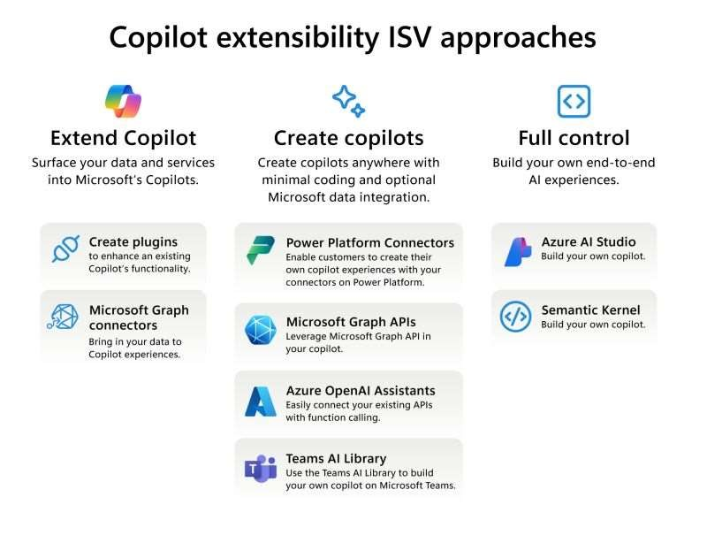
Low Code vs Full Code
Out of the box copilot
Copilot extensibility
Copilot Studio
Azure Studio
Semantic Kernel
Notes:
In AI projects, developers are involved in every phase, from problem identification to deployment and monitoring. They ensure data collection and preprocessing, model selection, training, and evaluation. Developers also make sure the project aligns with ethical AI practices. Original Content: Low code vs Full code Steps in an AI Project and the Developer's Involvement • Problem identification • Data collection and preprocessing • Model selection, training, and evaluation • Deployment and monitoring • Central to each phase, from conceptualization to deployment • Ensures the project aligns with ethical AI practices

Slide 16
Microsoft Copilot Limitations & Considerations
1. Licensing Model
📅 Annual Subscription Required
Fixed 1-year allocation; renewal dependent on organizational needs.
2. Data Scope Constraints
📊 Limited to Microsoft 365 Ecosystem
Access restricted to M365 data (e.g., Teams, SharePoint).
🗂️ File Size/Page Limits
May impact large-scale deployments.
Regular monitoring recommended to avoid disruptions.
3. Integration Limitations
🚫 No Connectivity to External Systems
Unsupported integrations:
Internal systems
Partners (Salesforce, Basware, Oracle, etc.)
Manual workflows required for third-party data sync.
4. Operational Risks
⚠️ Dependence on Product Updates
Features, pricing, and policies subject to change.

Slide 17
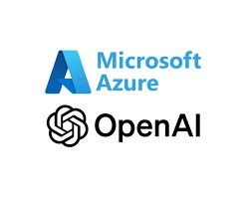
Azure Open AI
Differences from OpenAI
Real-world architectures
Load balancing article
Networking and Security
Data privacy
Security measures
Costs and Usage
API
Azure OpenAI Studio
Monitoring
Notes:
This slide covers key differences and features of OpenAI, including real-world architectures, networking and security, costs and usage, API, Azure OpenAI Studio, and monitoring. Original Content: • Differences from OpenAI • Real-world architectures (load balancing article) • Networking and Security • Data, privacy, and security • Costs and Usage • API • Azure OpenAI Studio • Monitoring

Slide 18
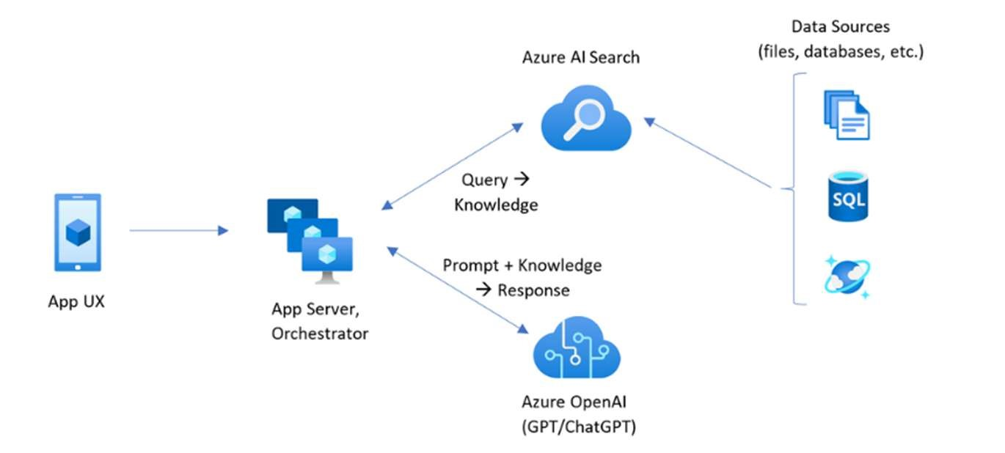
RAG
Pros:
Access to Real-Time Data
Scalability
Cost-Effective
Improved Accuracy
Reduced Risk of Hallucination
Cons:
Latency
Dependency on Data Quality
Complexity
Latency: 20-30% increase in response time compared to standalone generative models​
In certain use cases, RAG has been shown to improve accuracy by nearly 20%​
RAG systems typically reduce training costs by avoiding the need for extensive retraining, offering up to 40-60% savings
Notes:
This slide covers two design patterns: RAG and Architecture. RAG is used for status reporting, while Architecture defines the design structure and interactions of system components. Original Content: Design Patterns • RAG • Architecture

Slide 19
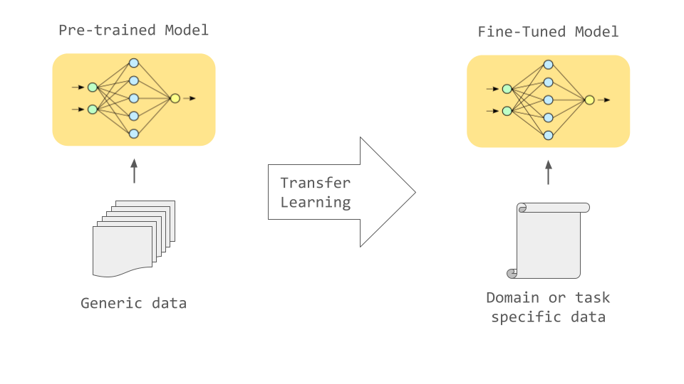
Fine Tune
Pros:
Task-Specific Optimization
Control Over Output
Higher Accuracy for Narrow Use Cases
Cons:
Cost-Intensive
Time Consuming
Fine-tuned models do not automatically update as new information becomes available, requiring periodic retraining, which adds to the cost and complexity.
Fine-tuning large models can take several days or even weeks, depending on the dataset and model size. For example, fine-tuning GPT-3 can take up to 1-2 weeks on a high-performance cluster​
Notes:
This slide covers two design patterns: RAG and Architecture. RAG is used for status reporting, while Architecture defines the design structure and interactions of system components. Original Content: Design Patterns • RAG • Architecture

Slide 20
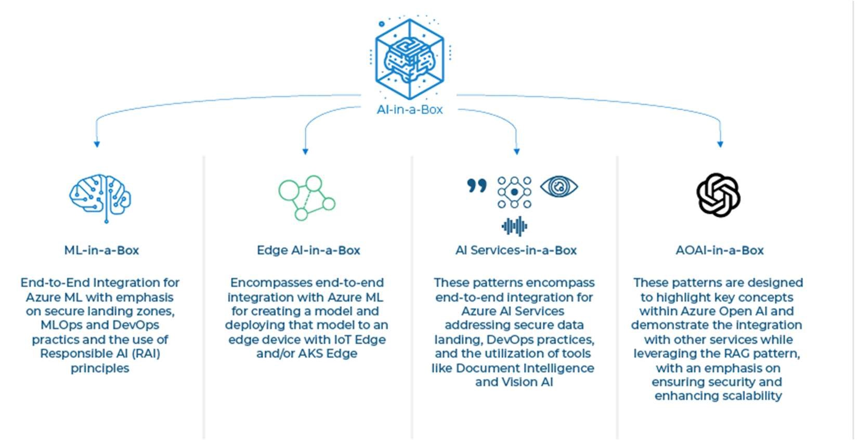
AI Orchestrator Details
Semantic Kernel
AI-in-a-Box/gen-ai/semantic
Langchain
kernel-bot-in-a-box at main · Azure/AI-in-a-Box · GitHub
Promptflow with Azure ML
GitHub Resources
https://github.com/microsoft/chat-copilot
https://github.com/langchain-ai/chat-langchain
AI Skills Impact
AI skills increase worker wages by 21% on average
Strong complementarities and rising demand in recent years
Notes:
The AI Orchestrator includes components like Semantic Kernel, Langchain, and Promptflow with Azure ML. GitHub resources are available for further exploration. AI skills significantly impact wages, increasing them by 21% due to their strong complementarities and rising demand. Original Content: AI Orchestrator • Semantic Kernel • AI-in-a-Box/gen-ai/semantic- • Langchain kernel-bot-in-a-box at main · Azure/AI-in-a-Box · GitHub • Promptflow with Azure ML • https://github.com/microsoft /chat-copilot • https://github.com/langchai n-ai/chat-langchain • ”We put our model to the test with a set of skills related to Artificial Intelligence (AI). We find that AI skills are particularly valuable – increasing worker wages by 21 % on average – because of their strong complementarities and their rising demand in recent years"

Slide 21
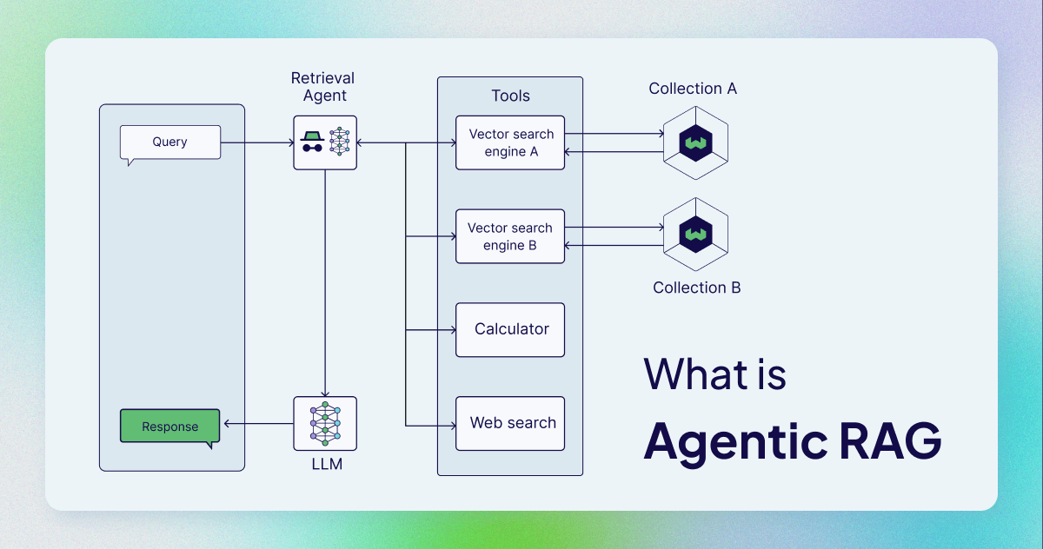
Notes:
This slide covers key features of Design Patterns and AI Orchestrator. Design Patterns focus on summarizing large documents, optimizing cost, and minimizing AI hallucinations. The AI Orchestrator enhances AI application development with semantic functions, templates, and hooks. Original Content: • Design Patterns Explore techniques for summarizing large documents with RAG and RAFT, focused on optimizing cost and performance while minimizing AIgenerated hallucinations. • AI Orchestrator The Semantic Kernel offers a framework for AI application development, enhancing functionality with semantic functions, templates, and hooks for efficient, intuitive design and integration.

Slide 22

Demo
Notes:
This is a demo presentation. Original Content: DEMO

Slide 23
References
References
• https://www.sciencedirect.com/science/article/pii/S0048733323001828
• https://www.statista.com/statistics/1365145/artificial-intelligence-market-size/
• https://github.com/luismanez/global-ai-madrid-2024/tree/main/src/CozyKitchen
• https://medium.com/@bijit211987/advanced-rag-for-llms-slms-5bcc6fbba411
Notes:
Here are some references that you can explore for more information on the topics discussed. Original Content: References • https://www.sciencedirect.com/science/article/pii/S0048733323001828 • https://www.statista.com/statistics/1365145/artificial-intelligence-market-size/ • https://github.com/luismanez/global-ai-madrid-2024/tree/main/src/CozyKitchen • https://medium.com/@bijit211987/advanced-rag-for-llms-slms-5bcc6fbba411

Slide 24

Slides
Notes:
Here are some references that you can explore for more information on the topics discussed. Original Content: References • https://www.sciencedirect.com/science/article/pii/S0048733323001828 • https://www.statista.com/statistics/1365145/artificial-intelligence-market-size/ • https://github.com/luismanez/global-ai-madrid-2024/tree/main/src/CozyKitchen • https://medium.com/@bijit211987/advanced-rag-for-llms-slms-5bcc6fbba411

